Slide 1
E-COMMERCE ANALYSIS
Unlocking Insights and Optimization Opportunities

Slide 2
CONTENT
Problem Statement
Objective
Tools Used
Approaches
Insights
Conclusion

Slide 3
PROBLEM STATEMENT
In the rapidly evolving landscape of e-commerce, understanding customer behavior and optimizing business strategies are crucial for success. A leading e-commerce platform aims to enhance its market position and increase revenue by leveraging data-driven insights. The company seeks to analyze its existing data to identify trends, patterns, and areas for improvement across various aspects of its operations.

Slide 4
OBJECTIVE
The e-commerce analysis project aims to analyze a dataset from an online retail platform to derive insights that can drive business decisions and optimizations. The primary objective of the analysis is to gain a deeper understanding of the e-commerce platform's performance, customer behavior, and market trends. By leveraging data analytics techniques we aim to uncover actionable insights that can enhance various aspects of the e-commerce business, such as marketing strategies, product recommendations, and operational efficiencies.

Slide 5
TOOLS USED
For an e-commerce analysis project in Python, use a variety of tools and libraries to perform data analysis, visualization, and presentation.
Jupyter Notebooks: Jupyter Notebooks provide an interactive environment for running Python code, analyzing data, and documenting your findings. Use Jupyter Notebooks to perform exploratory data analysis (EDA) and create visualizations.

Slide 6
Pandas: Pandas is a powerful library for data manipulation and analysis in Python. Use Pandas to clean, preprocess, and analyze e-commerce dataset, as well as perform tasks such as data aggregation, filtering, and grouping.
Matplotlib: Matplotlib is a widely-used plotting library in Python for creating static, interactive, and publication-quality visualizations. Use Matplotlib to create various types of plots, including line plots, scatter plots, histograms, and bar charts to visualize e-commerce data.

Slide 7
Seaborn: Seaborn is built on top of Matplotlib and provides a high-level interface for creating attractive and informative statistical graphics. Seaborn includes functions for creating complex visualizations such as pair plots, heatmaps, and Count plots, which can be useful for exploring relationships e-commerce data.
Plotly: Plotly is a versatile visualization library that supports interactive plotting and dashboards. Use Plotly to create interactive charts, maps, and dashboards that can be embedded into Jupyter Notebooks.

Slide 8
APPROACHES
Data Collection and Preparation: Gathering and preprocessing the dataset to ensure data quality and consistency. This involves tasks such as handling missing values, removing duplicates, and transforming data into a suitable format for analysis.
Exploratory Data Analysis (EDA): Conducting exploratory data analysis to understand the distribution of variables, identify patterns, and uncover correlations within the dataset. Visualization techniques such as histograms, scatter plots, and heatmaps will be used to gain insights into customer behavior, product preferences, and sales trends.

Slide 9
Recommendations and Insights: Generating actionable recommendations and insights based on the analysis findings. These insights will inform strategic initiatives aimed at improving customer engagement, increasing sales revenue, and enhancing overall business performance.

Slide 10
INSIGHTS
Popular Product Categories & Brands
1. Clothing & Accessories
2. Footwear
Top Brands
1. ARBO
2. Pu
3. True BL
4. REEB
5. ECKO Uni

Slide 11
Top Sub Categories
1. Top wear
2. Bottom wear
3. Winterwear
4. Innerwear and Swimwear

Slide 12
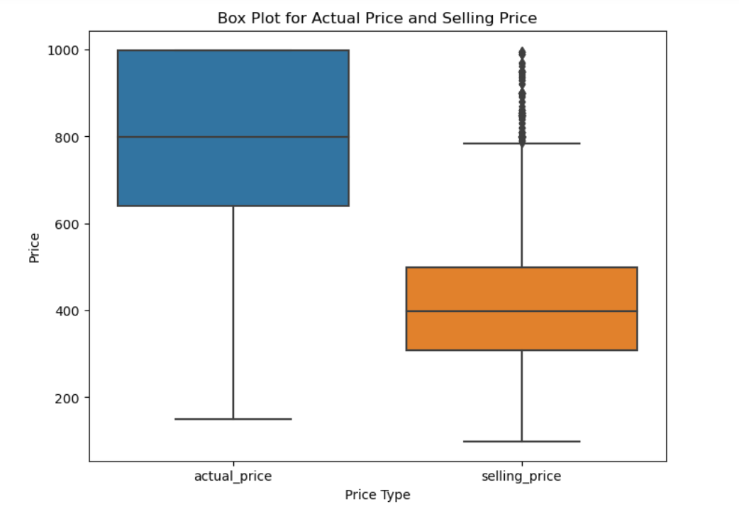
Pricing Strategies

Slide 13
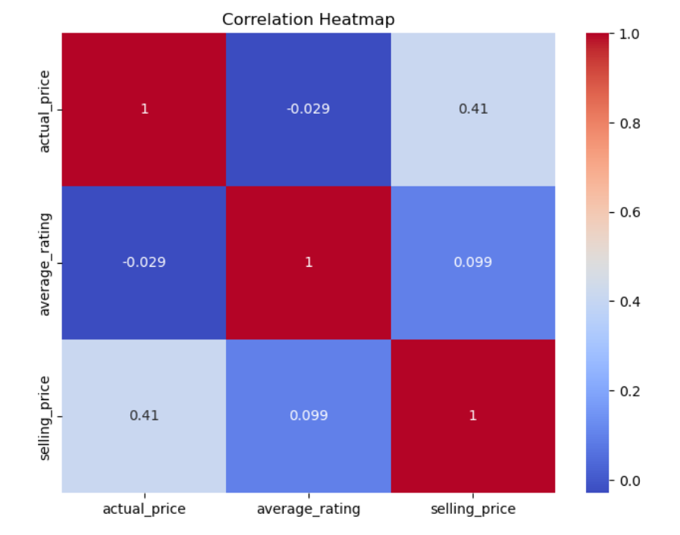

Slide 14
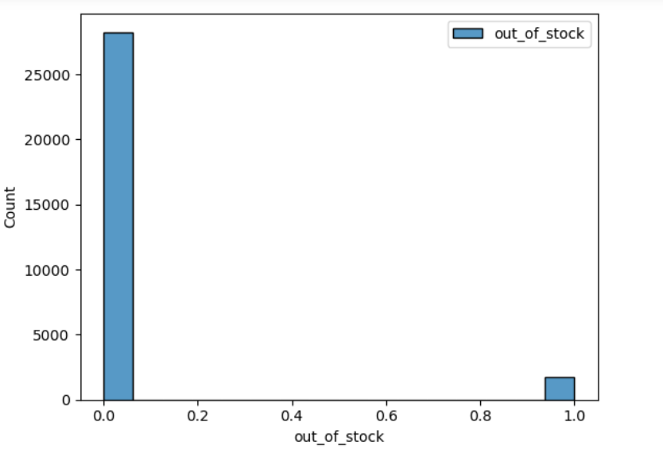

Slide 15
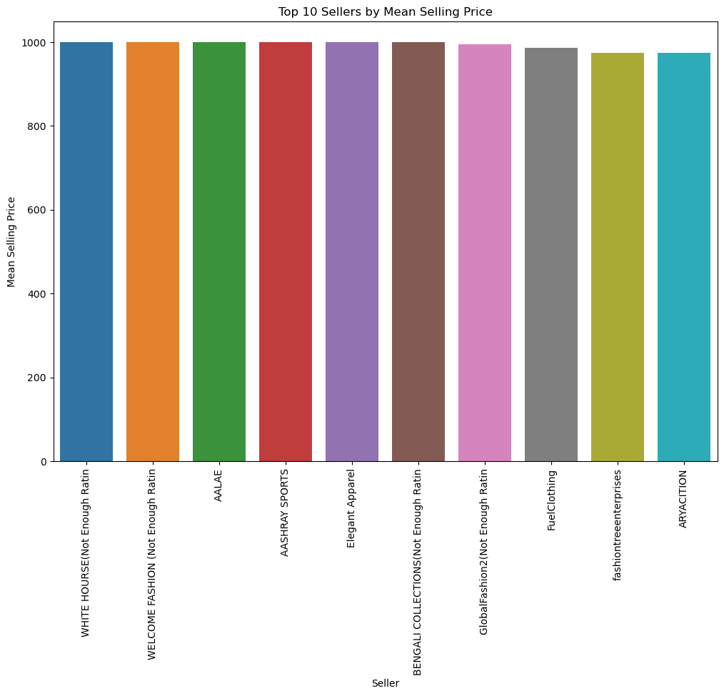
Seller Performance

Slide 16
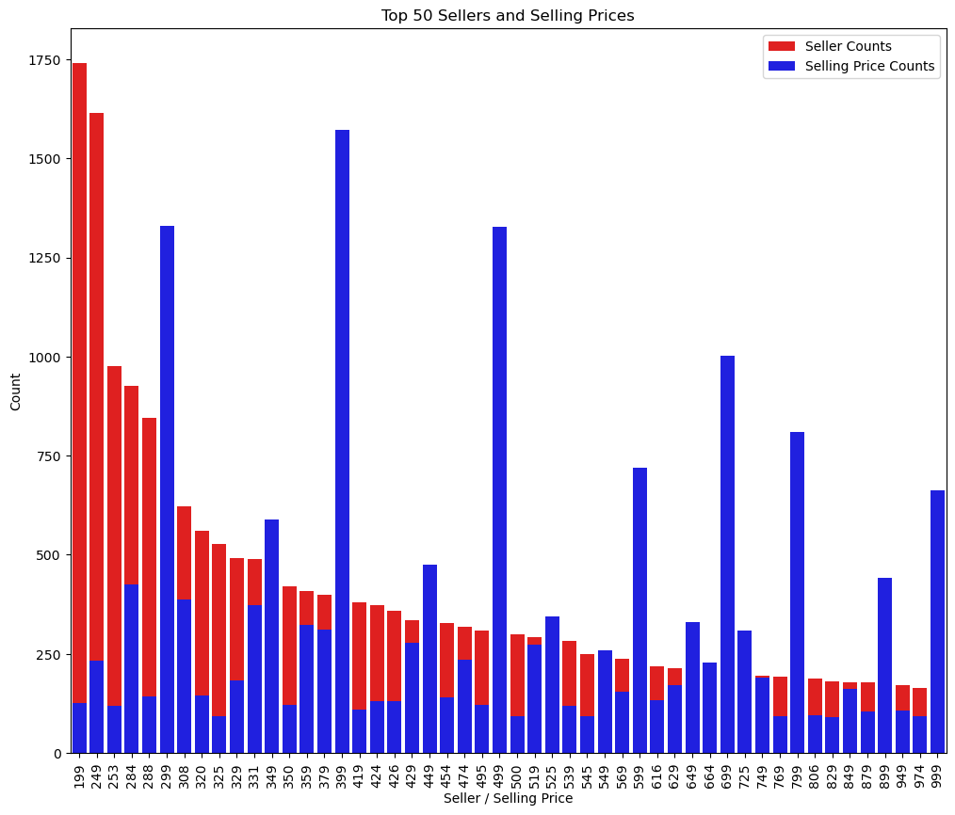

Slide 17
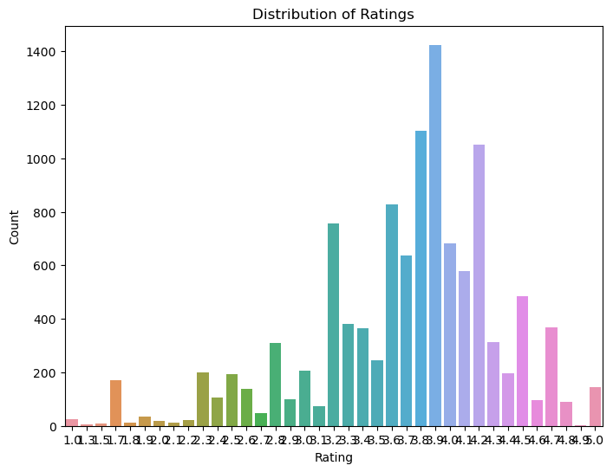
Customer Preferences

Slide 18
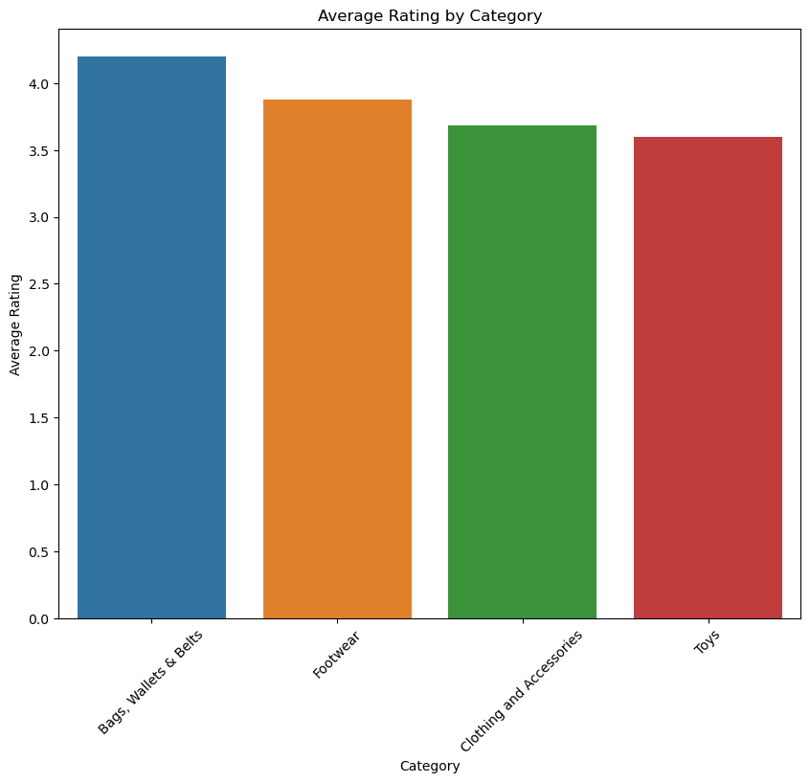

Slide 19
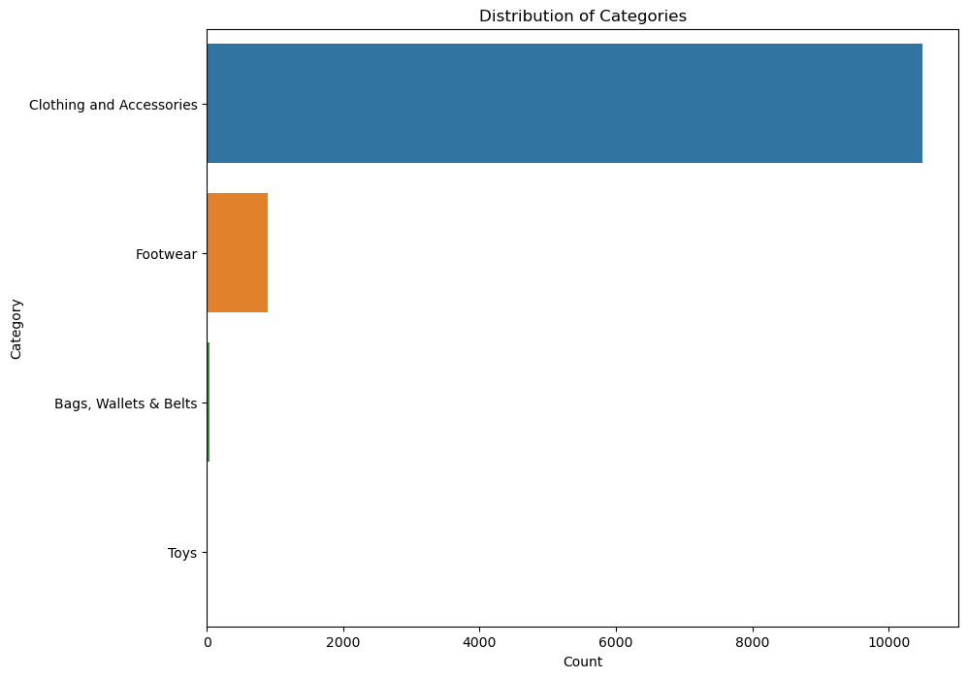

Slide 20
CONCLUSION
The e-commerce analysis project aims to leverage data-driven insights to drive business growth and innovation in the competitive online retail landscape. By harnessing the power of data analytics, seek to unlock hidden opportunities and deliver value to both the business and its customers.

Slide 21
THANK YOU

